Slide 1

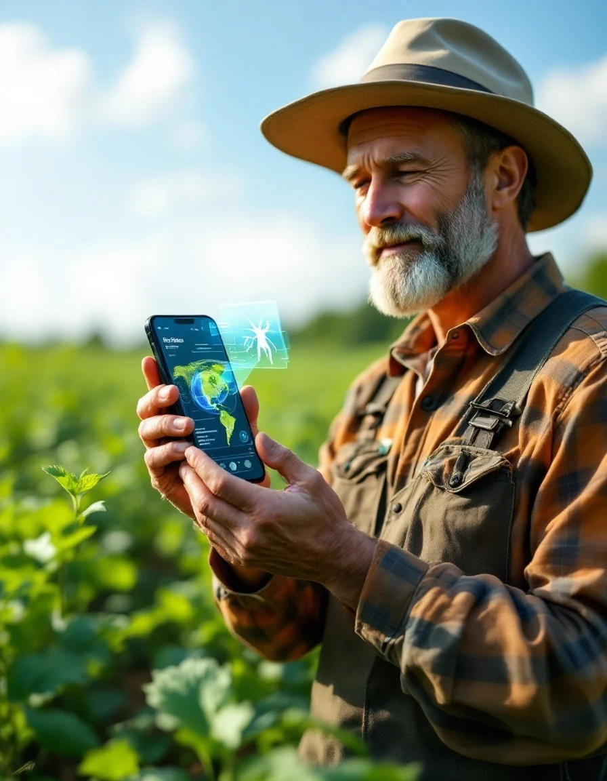











Neil Gogte Institute of Technology
Mobileplant vit-lda
Empowering mobile intelligence for a sustainable agricultural future.
Mentor: dr.M.deepika
Presented by:
Abbanaboina Vaishnavi - 245323733001
Vaitla Sreeja - 245323733056
Astha Kumari - 245323733301
Himasree Gangisetti - 245323733305
Sangineedi Chaitanya Satya Balaji - 245323733307

Slide 2










Introduction
Plant diseases significantly threaten global agriculture, affecting crop yield and quality.
Rapid and precise disease detection is vital to ensure plant health and reduce economic loss.
Current deep learning models are complex for mobile deployment.
They struggle with noisy or low-resolution real-world images.
Goal: Develop a lightweight, robust, and efficient Vision Transformer for real-time plant disease detection on mobile devices.

Slide 3






Base paper
High Computational Cost
MobilePlantViT combines MobileNetV2 and Vision Transformer (ViT) for mobile-based plant disease detection.
Uses MobileNetV2 for efficient local feature extraction.
Integrates lightweight transformer modules to capture long-range dependencies.
Achieves high accuracy with low computational cost, ideal for real-time mobile use.
Most deep learning models are too large for mobile devices.
MobilePlantViT employs a lightweight hybrid design to cut parameters and computation.
Limited ContextAwareness
limited context awareness
CNN-based models miss global context in images.
Vision Transformer blocks capture long-range dependencies effectively.

Slide 4





Problem definition
01
Agricultural Challenge
02
Technical Limitation
Manual detection is slow and unreliable threatening crop yield and food security
40% of crop yield is lost annually due to diseases.
CNNs detect only local features, missing overall patterns.
Vision Transformers improve accuracy but are computationally expensive.
03
Practical Limitation
04
Why It Matters
Farmers in rural areas lack affordable and accessible AI tools.
No real-time, on-field diagnosis available.
Ultra-lightweight, energy-efficient, and mobile-optimized.
Designed for real-world deployment.

Slide 5


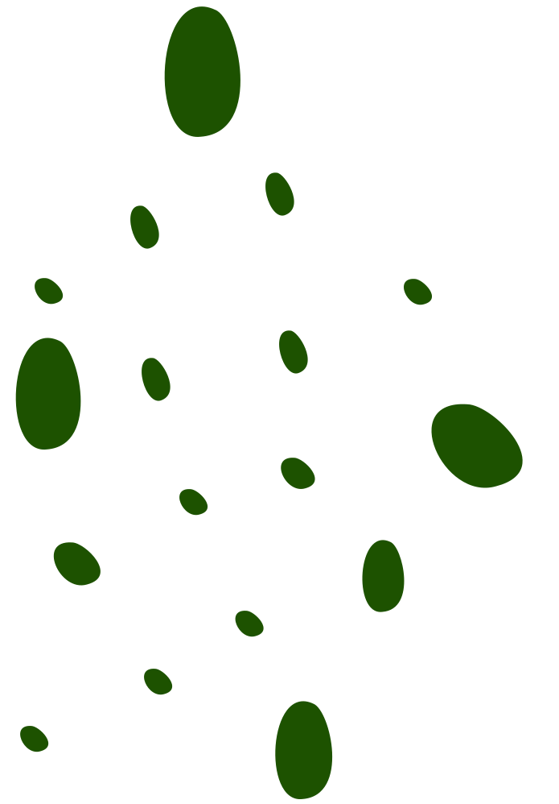


Scope of project
MobilePlantViT is a lightweight AI model designed to detect plant diseases from leaf images.
The upgraded version aims to be faster, more efficient, and more accurate than the original.
It processes images through an optimized architecture to identify plant diseases with high precision.
The improved model will be tested on multiple plant image datasets to evaluate its accuracy and performance.
The ultimate goal is to enable real-time, on-device disease detection for smartphones and other low-power devices.
in-scope
Enhance MobilePlantViT to achieve faster and more accurate plant disease detection.
Integrate multilingual TTS for spoken results.
Provide real-time weather updates within the app.
out-of-scope
Real-time video detection, deferred due to computational and time constraints.
Pest and nutrient deficiency detection, excluded for lack of suitable labeled datasets.
Treatment recommendation module, omitted due to unavailability of validated agronomy data.

Slide 6





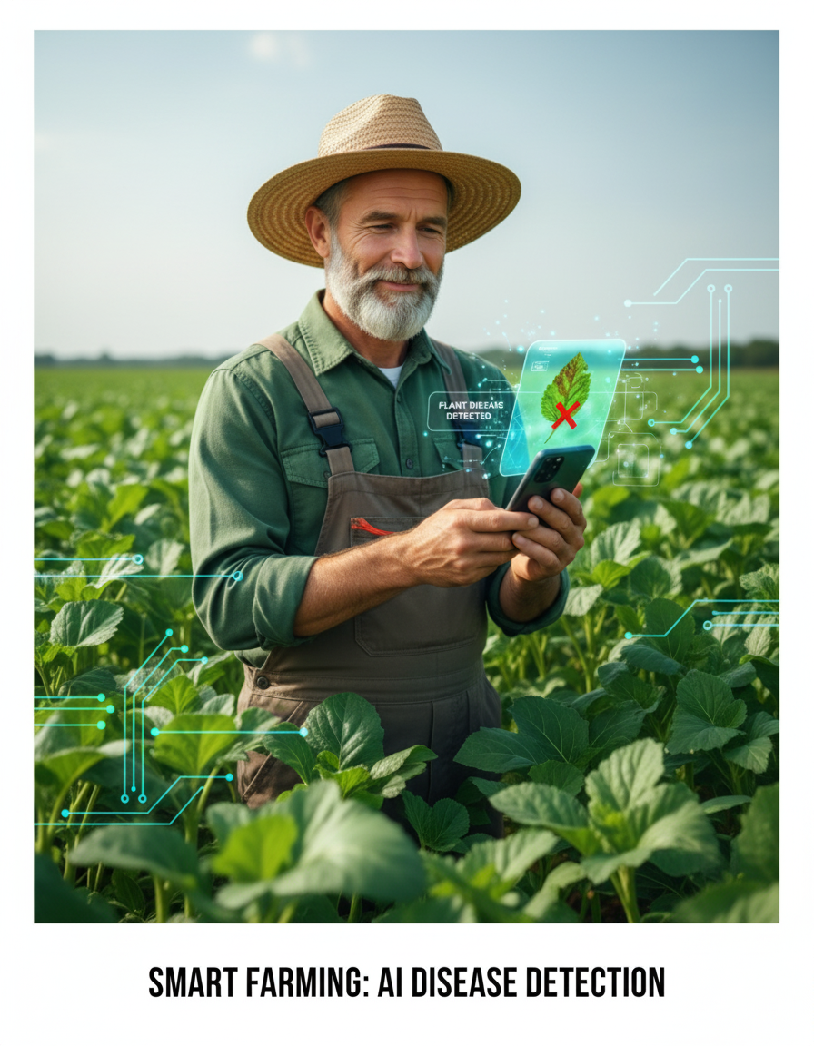

proposed solution
We propose an upgraded version of MobilePlantViT by replacing key blocks with more advanced modules for better performance on real-world, noisy images:
DepthWise Convolution → GhostConv
CBAM → Coord Attention
Group Conv → Fused-Inverted Residual Block
Linear Self-Attention → Linear Differential Attention
FFN → Bottleneck FFN
These upgrades aim to improve feature extraction, reduce computational overhead, and maintain high accuracy for mobile deployment.

Slide 7




Accurate Disease Detection
Accurately identifies diseases across various crops.
Performs reliably on noisy or imperfect images.
Mobile-Friendly Deployment
Lightweight and optimized for mobile devices.
Enables farmers to capture images and receive instant results anywhere.
expected outcome
Multi-crop disease classification
Robust to noisy/real-world images
Lightweight for mobile devices
Quick and reliable diagnosis
Faster and Reliable Diagnosis
Automated detection saves time and avoids manual errors.
Provides farmers with timely, actionable insights to protect crops.

Slide 8

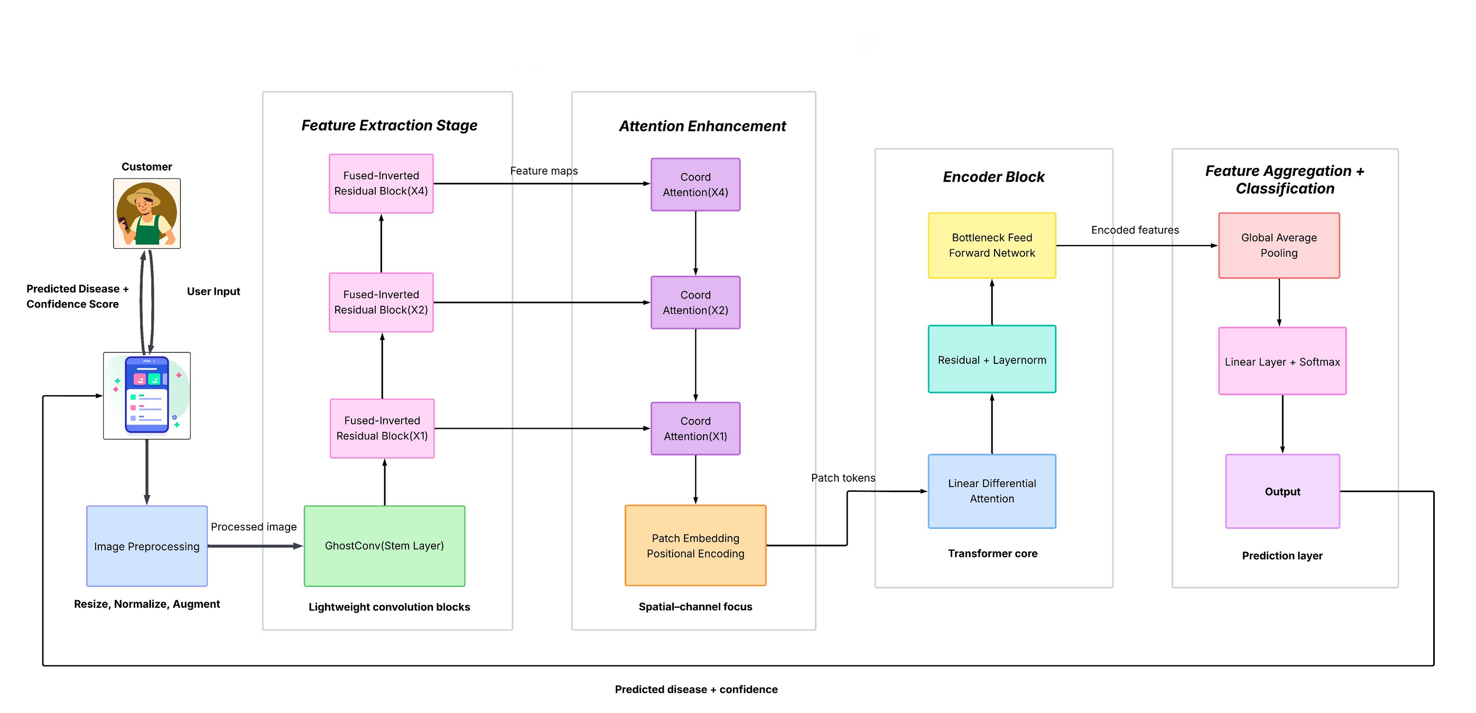
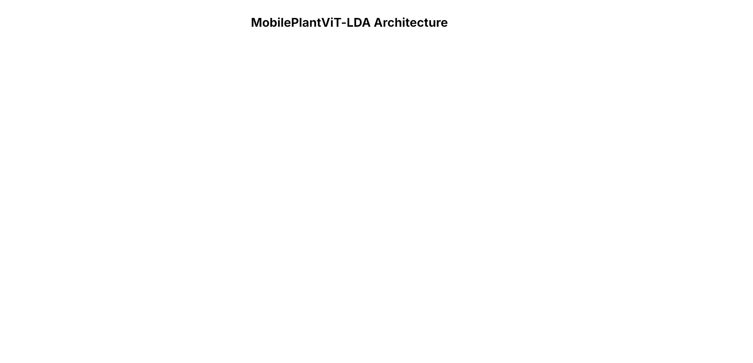

architecture diagram

Slide 9








RECAP
Quick recap
Analyzed MobilePlantViT to identify existing limitations.
Selected replacement blocks to improve performance and robustness.
Planned mobile-friendly, multi-crop disease detection using upgraded architecture.
by next milestone...
Begin implementation of the new architecture with the selected replacement blocks.
Test basic functionality and run preliminary experiments on sample datasets.
THANK YOU!!!

